Slide 1
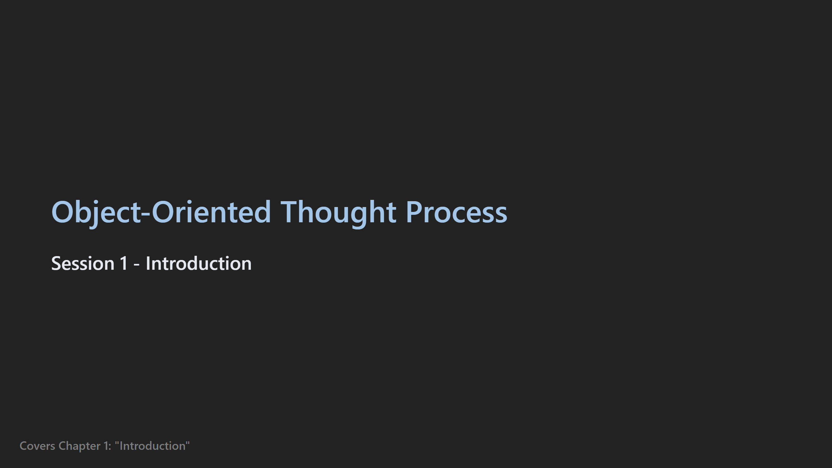
Notes:
notes

Slide 2
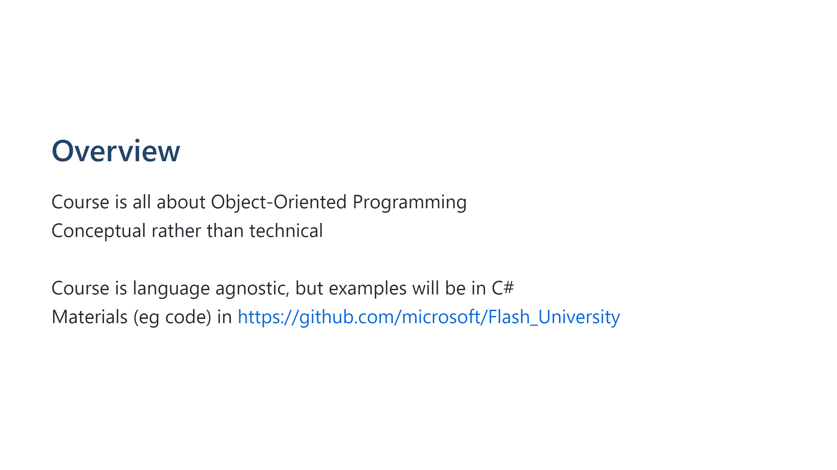
Notes:
notes questions/discussion welcome throughout focus on conceptual things & design rather than implementation but questions on how it works in C# - ask!

Slide 3
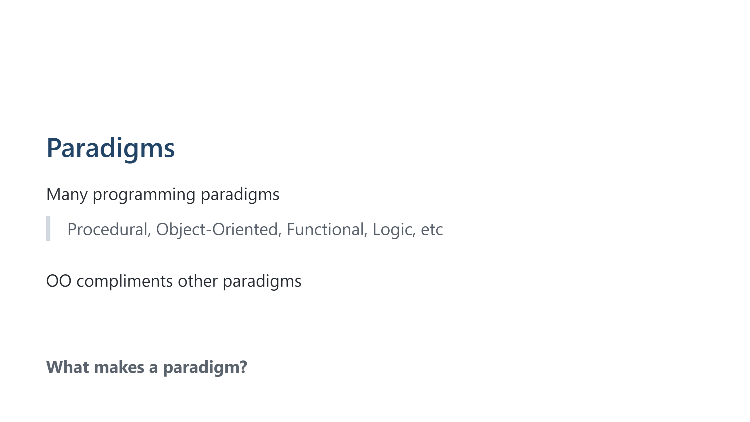
Notes:
notes paradigm is a way of thinking/modeling most languages have aspects of multiple paradigms (C# has delegates, LINQ)

Slide 4
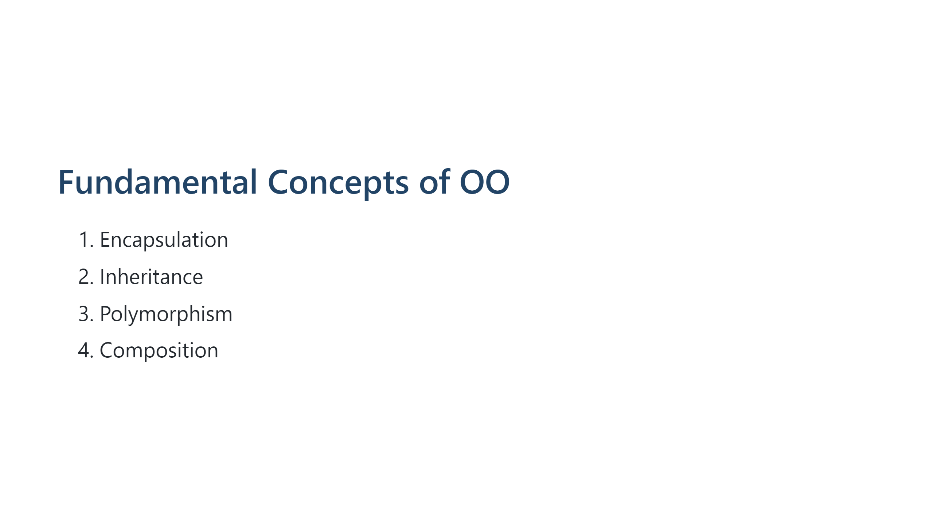
Notes:
notes

Slide 5
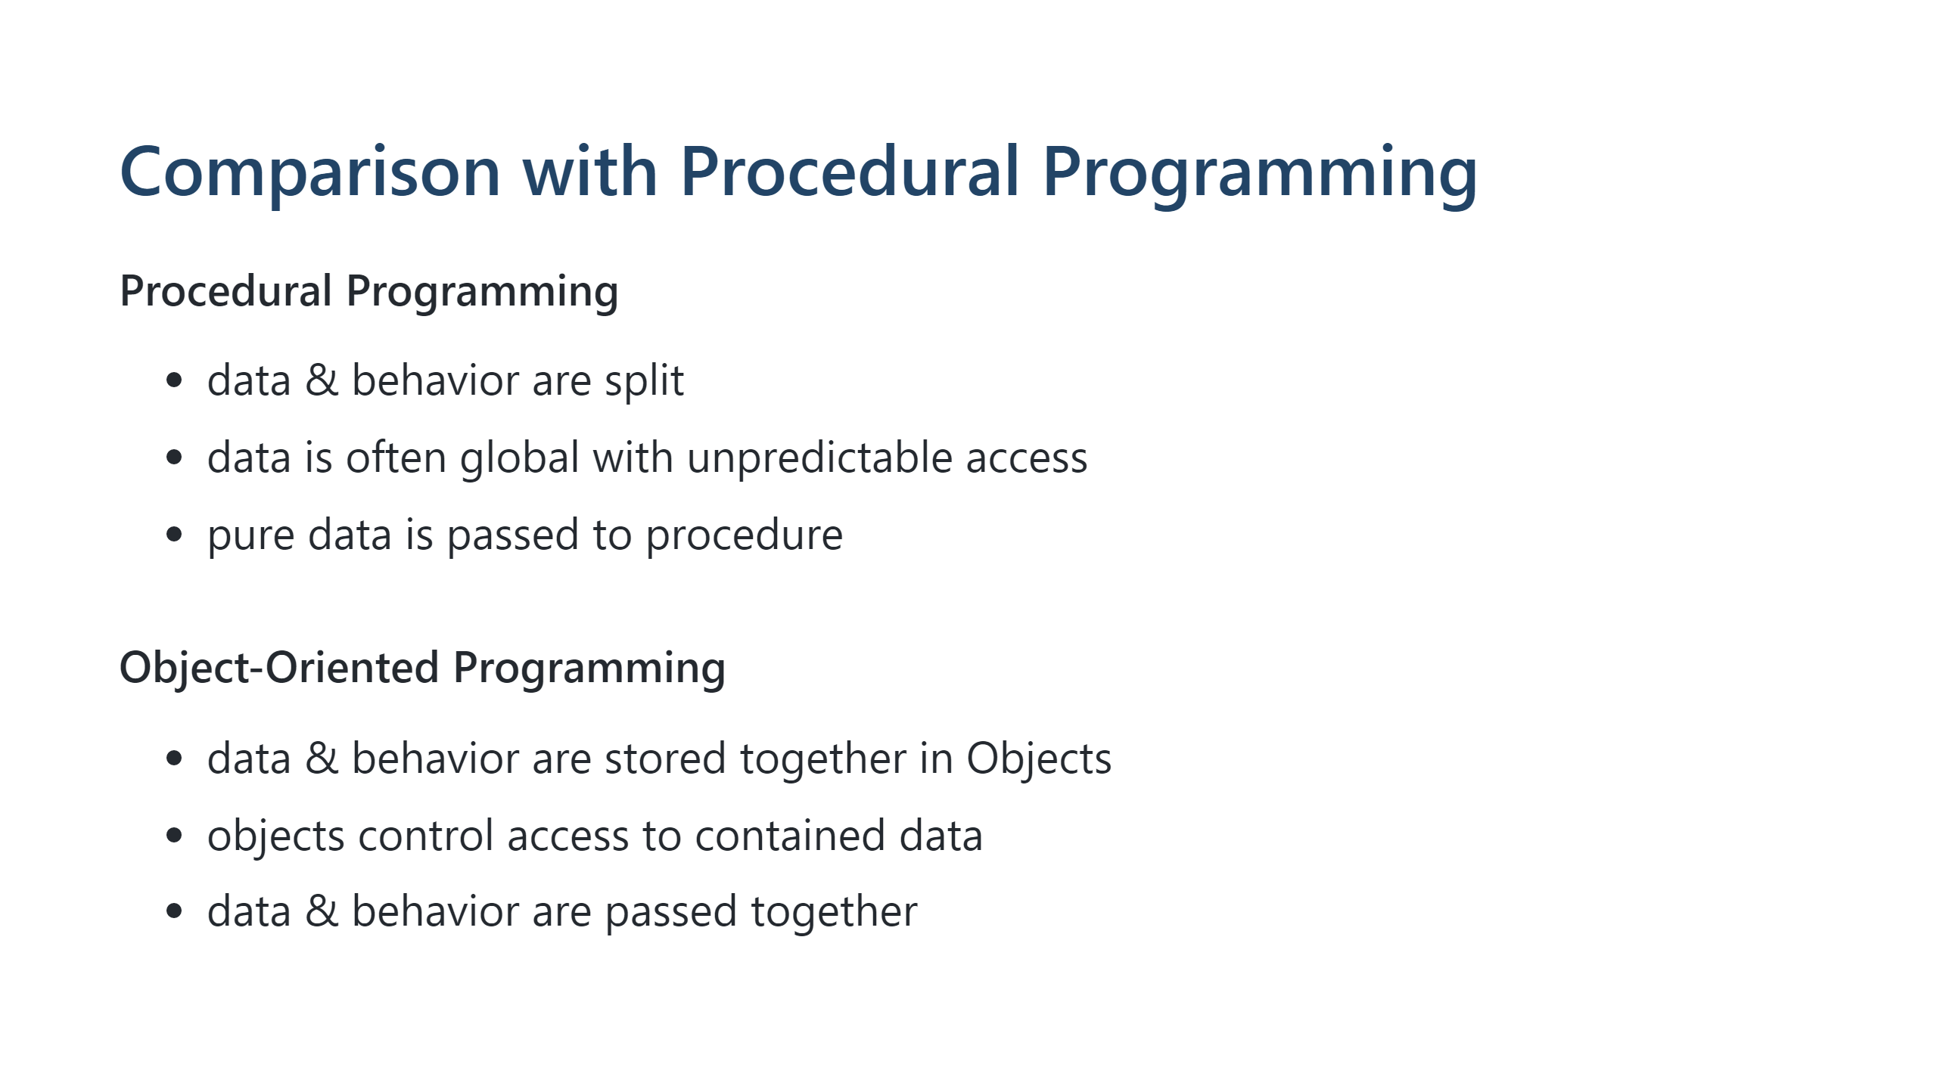
Notes:
notes

Slide 6
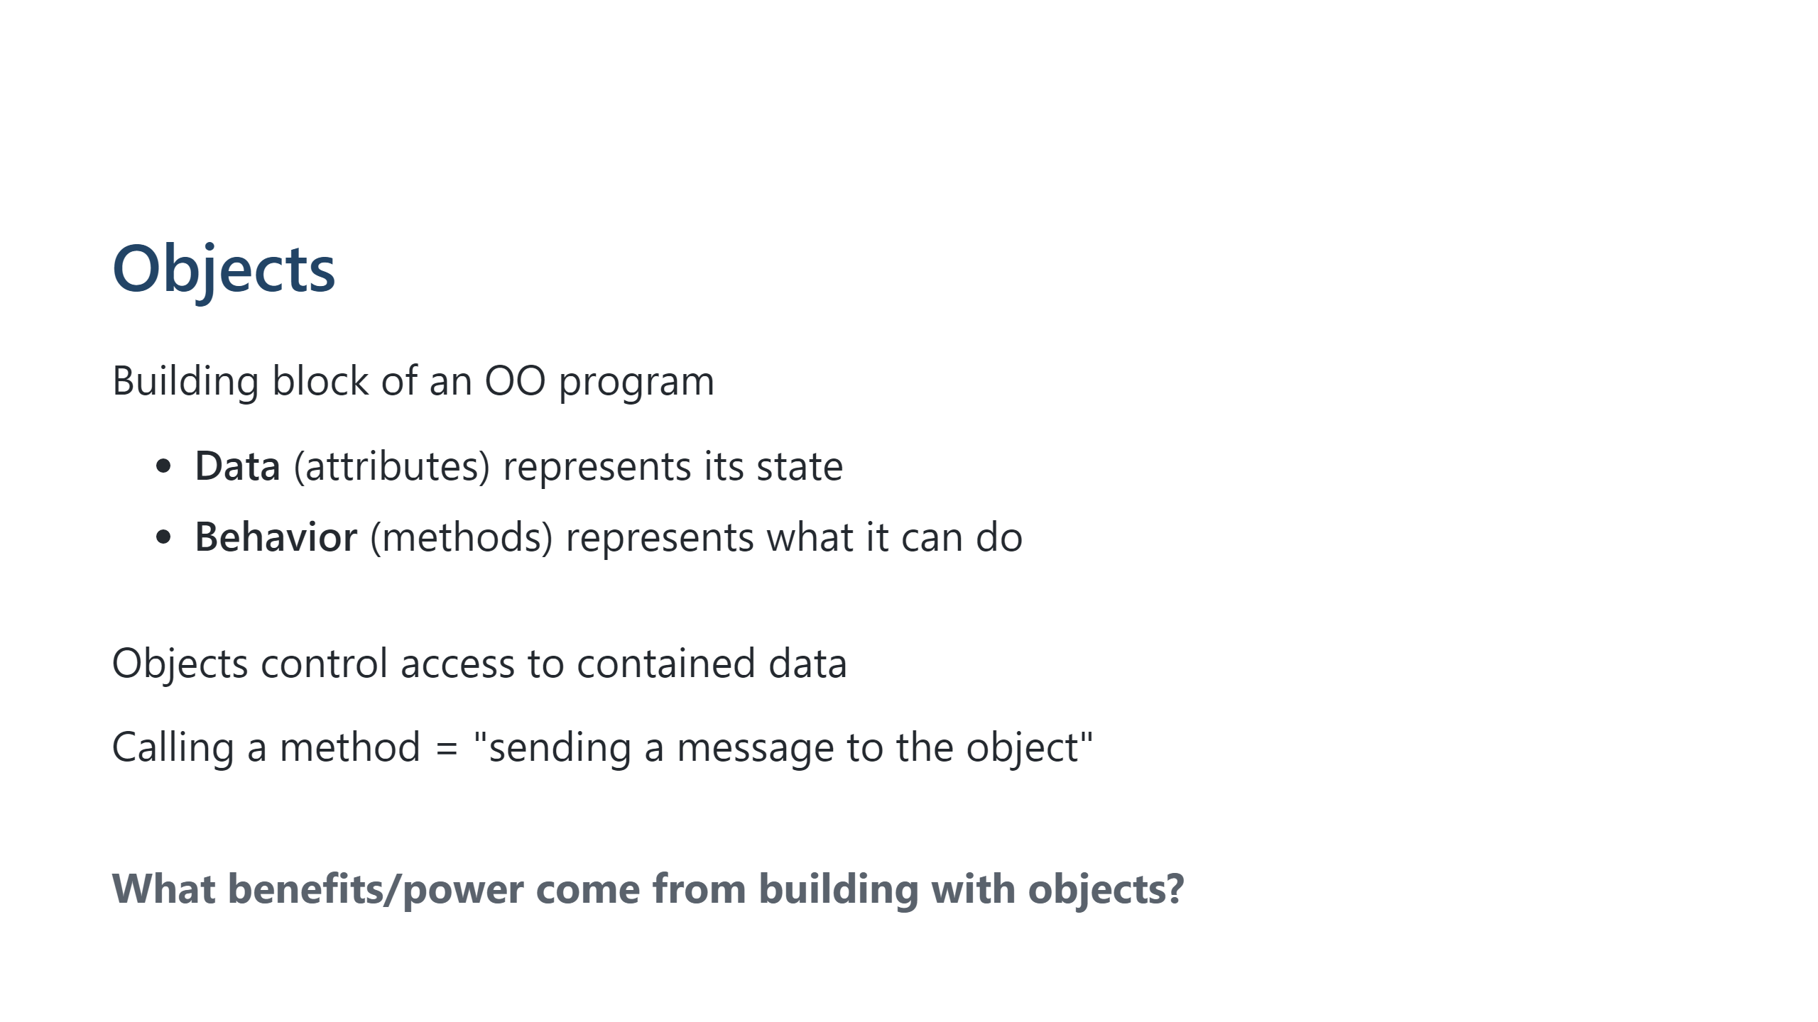
Notes:
notes

Slide 7
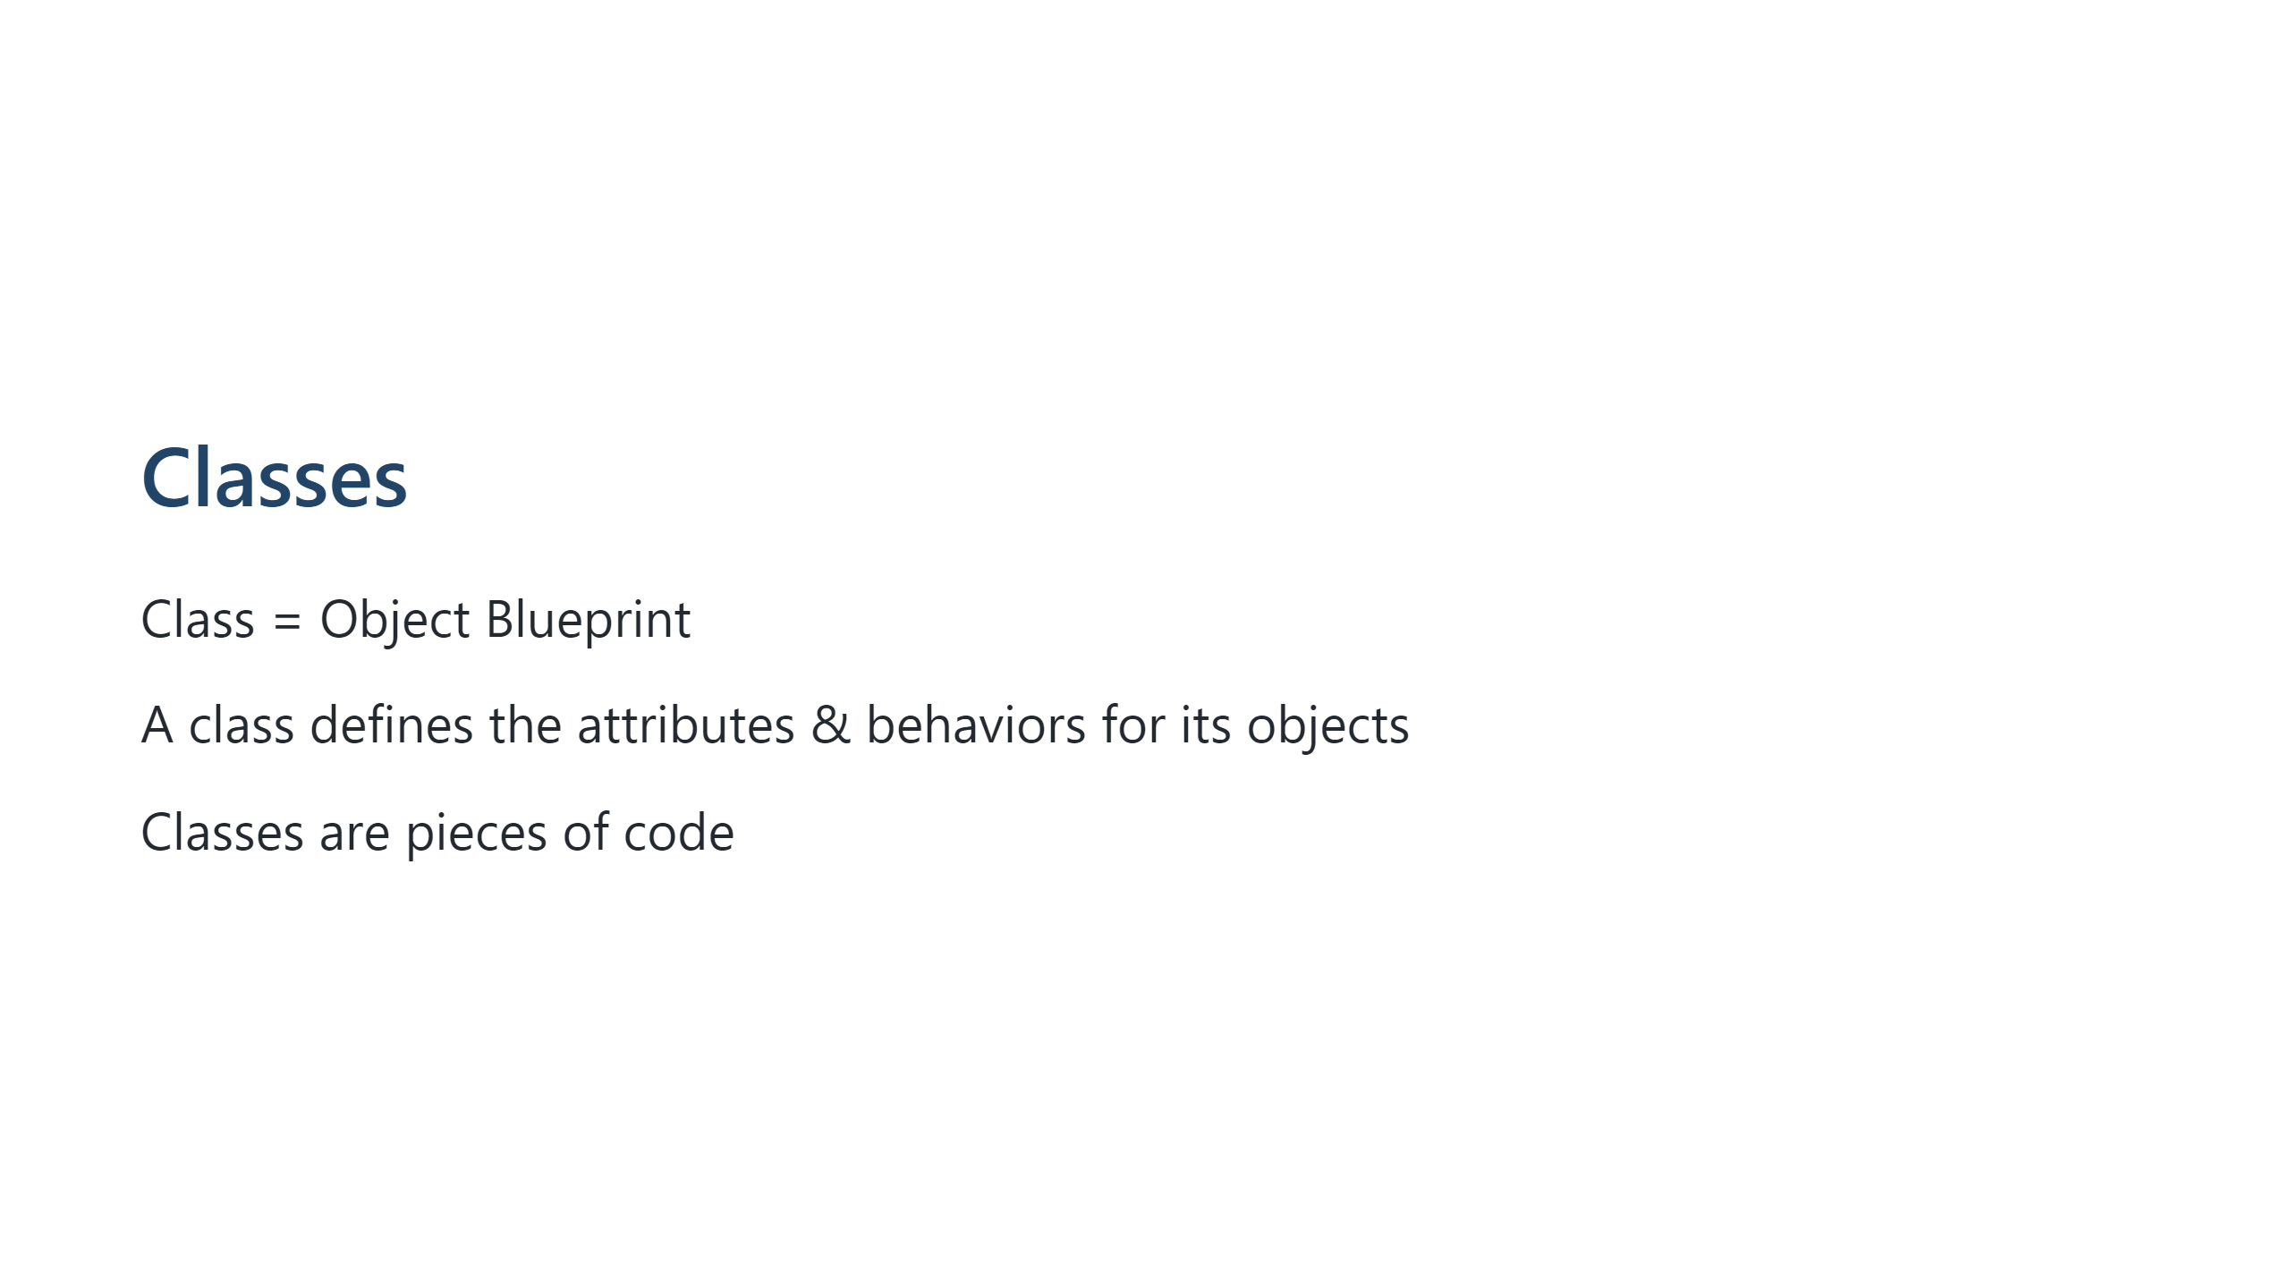
Notes:
notes

Slide 8
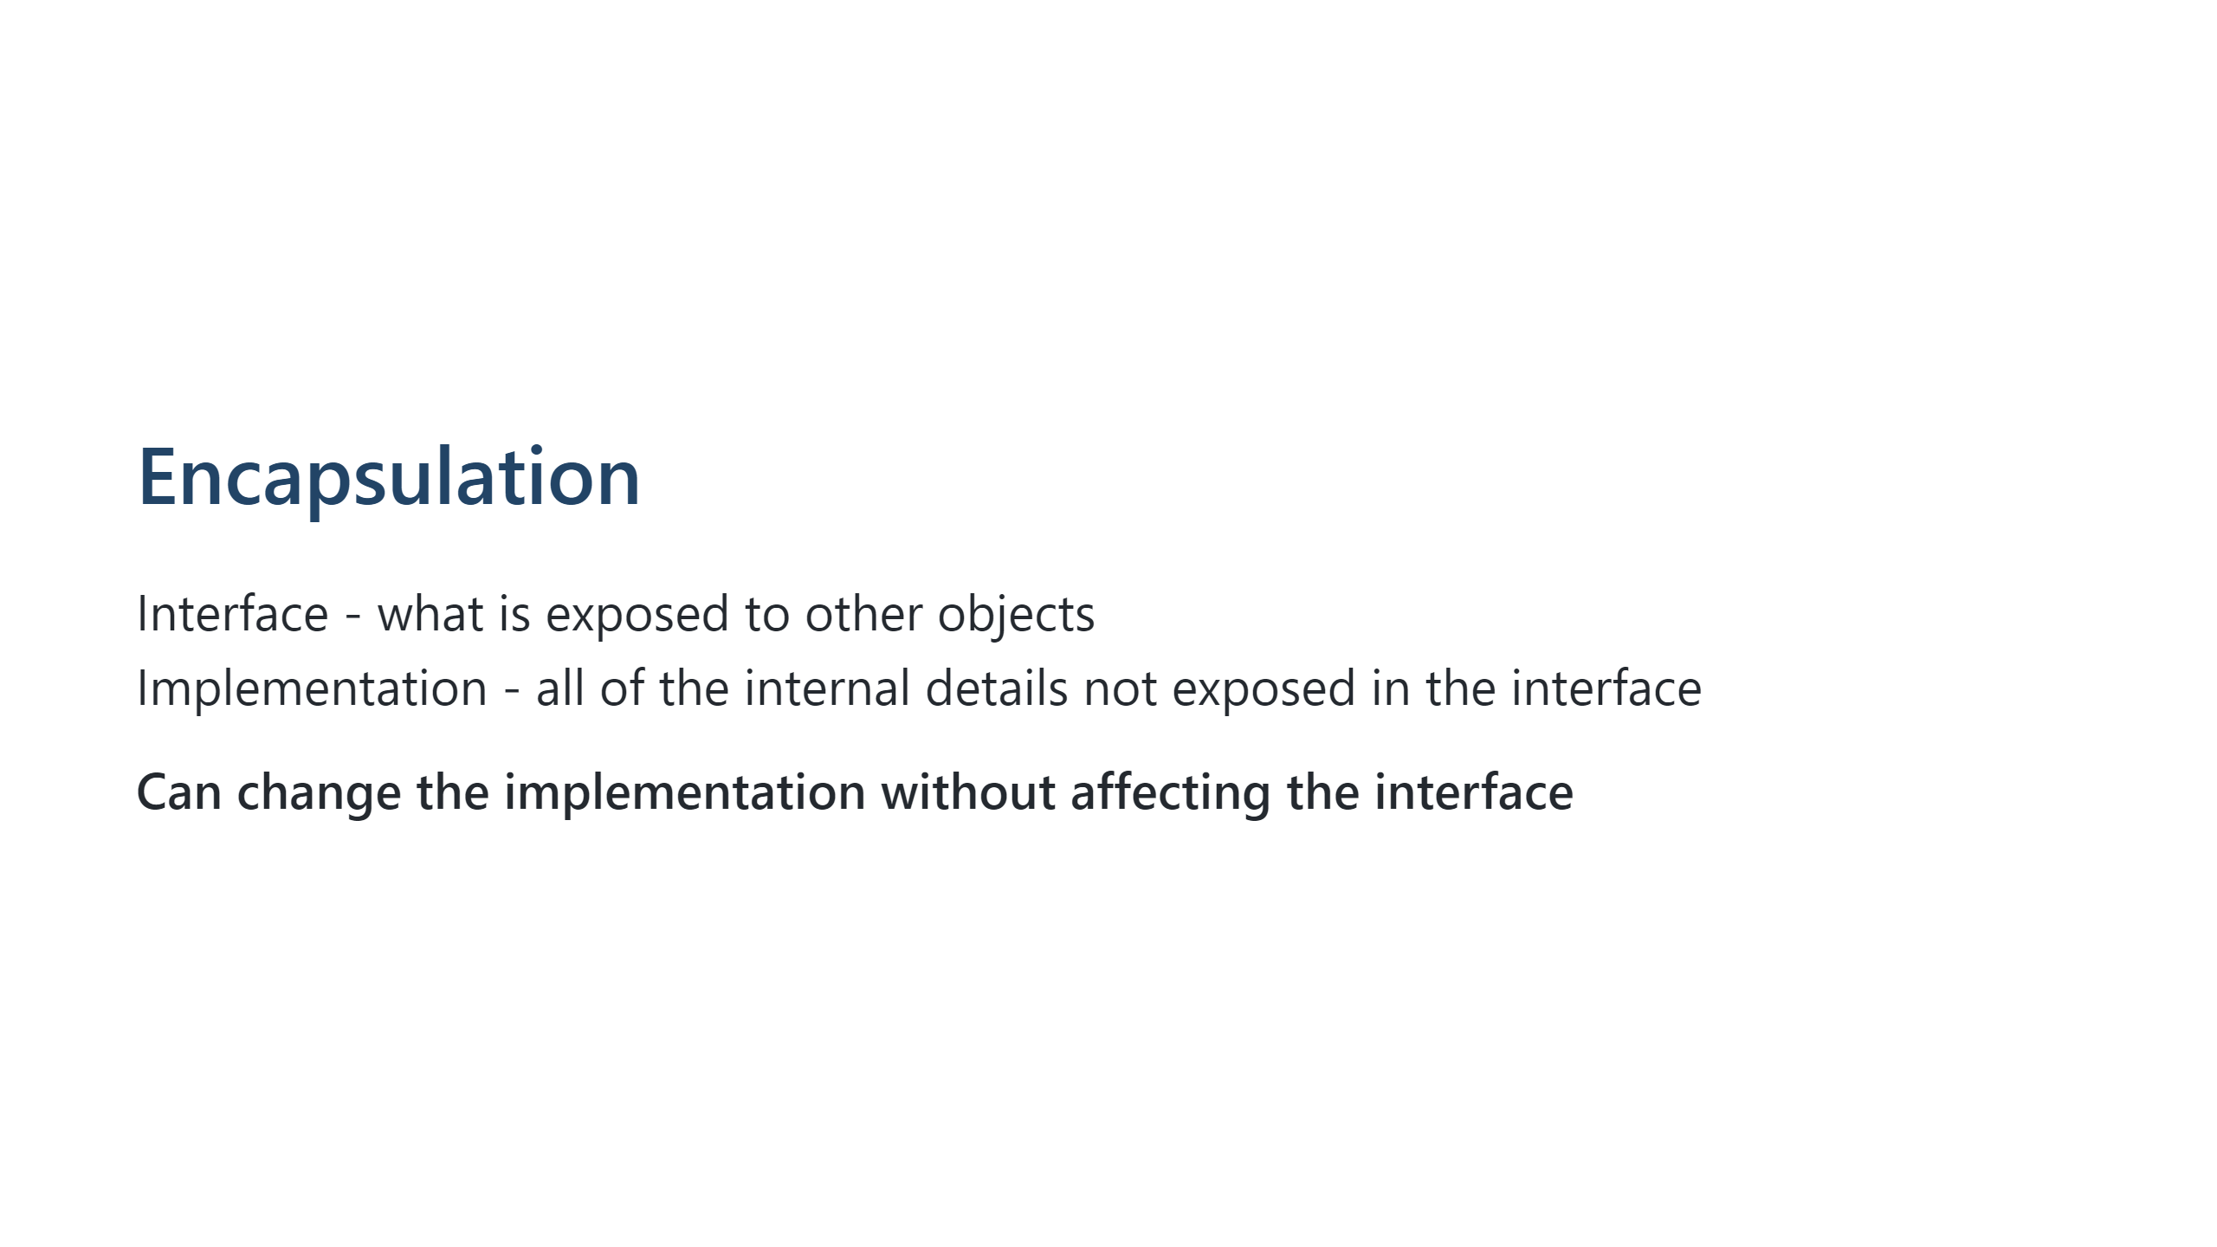
Notes:
notes can see this on a micro & macro level (object interfaces, library APIs, web APIs, etc)

Slide 9
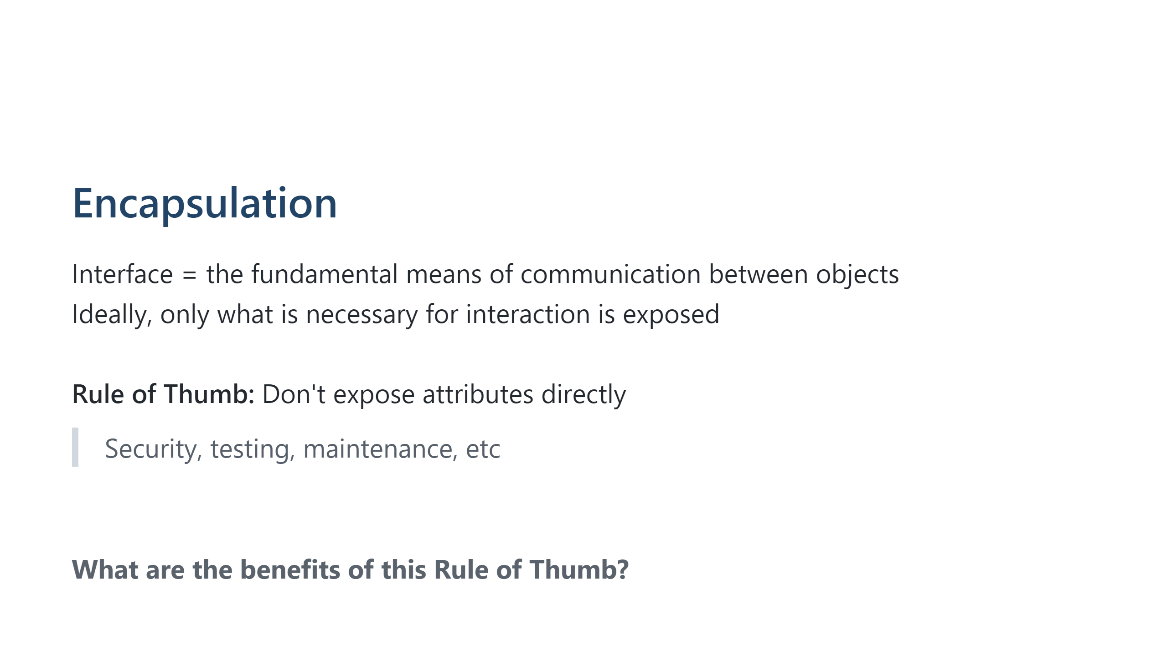
Notes:
notes attributes are part of the implementation (they are the state) exposing attributes ties the interface to the implementation

Slide 10
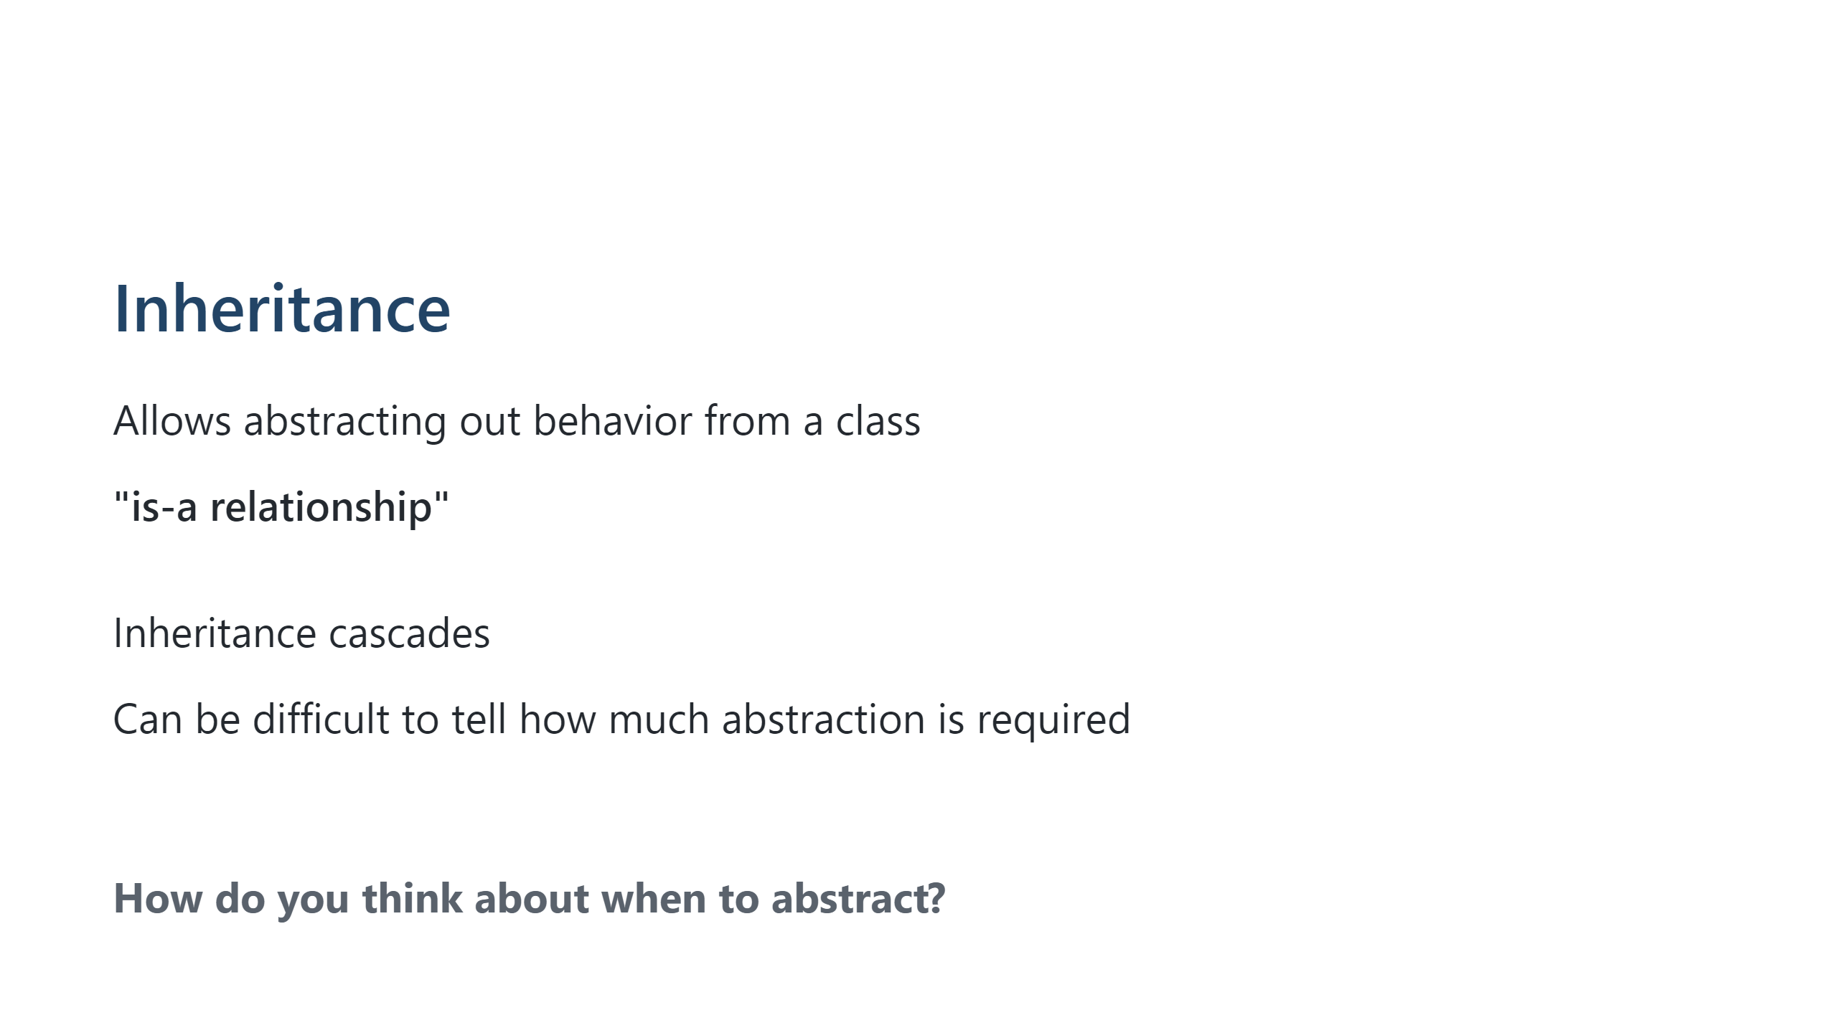
Notes:
notes

Slide 11
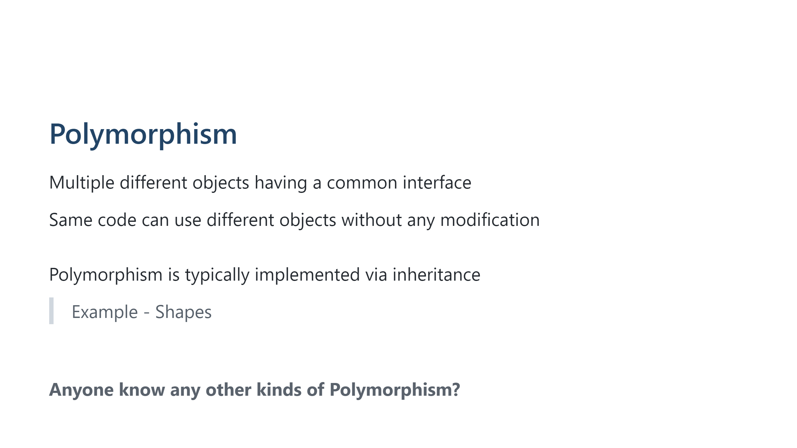
Notes:
notes different objects have different implementations inheritance = "subtype polymorphism" 2 components - use subclass as superclass - and invoke method which invoke's the subclass's method ("abstract" or "virtual")

Slide 12
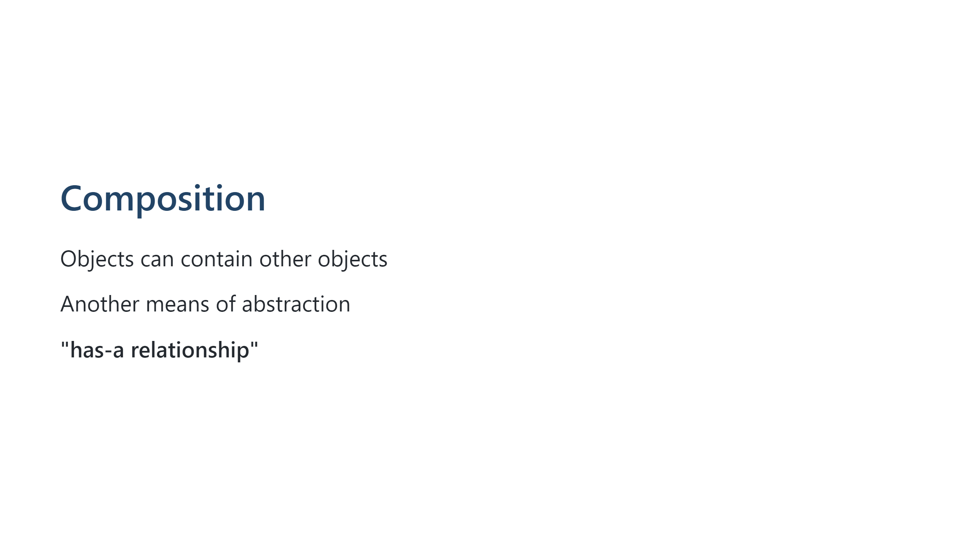
Notes:
notes

Slide 13


